Slide 1

Mobile Learning Application Development
Presented By:
Rakib Hossen
Assistant Professor
Dept. of Cyber Security Engineering (CySE), GDU

Slide 2




Content
Introduction of Dart Programming Language
Dart Environment
Dart SDK Setup
Dart Syntax
Datatype
Variables
Operators

Slide 3



Dart
❏Core Of Flutter Framework
❏Programming Language like Java ,C# ,C++
❏Dart is a client-optimized programming language for apps on multiple platforms.
❏It is developed by Google and is used to build mobile, desktop, backend and web applications.
❏First appeared: October 10, 2011; 11 years ago
❏Designed by Lars Bak and Kasper Lund
❏ Supports two types of compilation techniques.
AOT (Ahead of Time) - It converts the Dart code in the optimized JavaScript code with the help of the dar2js compiler and runs on all modern web-browser. It compiles the code at build time.
JOT (Just-In-Time) - It converts the byte code in the machine code (native code), but only code
that is necessary

Slide 4

Why Dart ?
❏The characteristics of Dart in the following point.
Dart is a platform-independent language and supports all operating systems such as Windows, Mac, Linux, etc.
It is an open-source language, which means it available free for everyone. It comes with a BSD license and recognized by the ECMA standard.
It is an object-oriented programming language and supports all features of oops
such as inheritance, interfaces, and optional type features.
Dart is very useful in building real-time applications because of its stability.

Slide 5



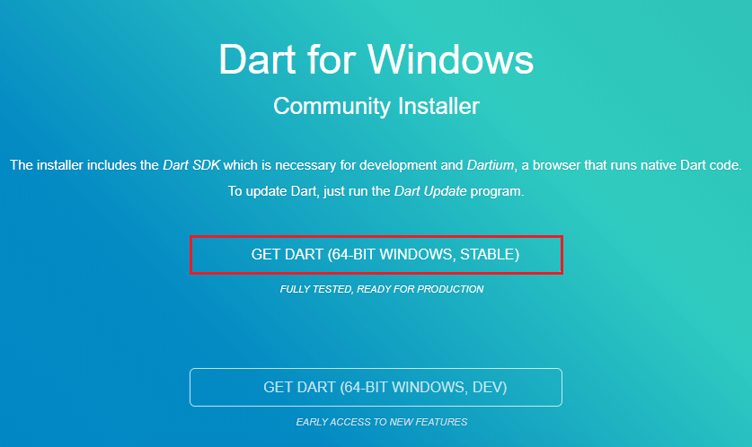
Dart Installation
❏Install the Dart SDK on Windows
❏Go to the browser and type the following link to download the SDK.
❏http://www.gekorm.com/dart-windows/
❏It will open the given page. Click on the following link.
❏ Run the Dart installer(It is the .exe file that we downloaded in the previous step) and click on the Next button.
❏It provides the option to select the Dart installation path. After the path is selected, click on
the Next button.

Slide 6



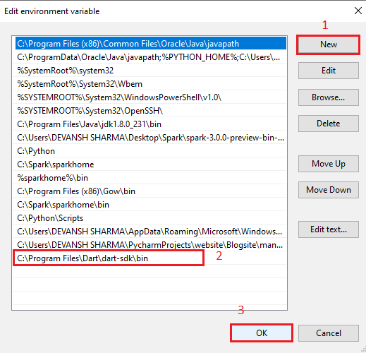
Dart Installation
❏After the download is completed, set the PATH environment variable to "C:\Program Files\Dart\dart-sdk\bin" in advance system properties.
❏ Now open the terminal and verify the Dart installation by typing dart.

Slide 7

Dart Environment
❏Online Environement: https://dartpad.dartlang.org
❏Local Environments:
❏https://gekorm.com/dart-windows
❏https://www.jetbrains.com/idea/download

Slide 8

Dart Syntax
Syntax is called set of rules for writing programs.
Variables and Operators
Classes
Functions
Expression and Programming Constructs
Decision Making and Looping Constructs
Comments
Libraries and Packages
Data structure represented as Collections / Generics

Slide 9

Dart Syntax
Whitespace and Line Breaks
  Dart ignores spaces, tabs, and newlines that appear in the program.
Dart is Case-sensitive
  Dart differentiates between uppercase and lowercase characters.
Statements end with semicolon
  Each line of instruction is called a statement and a statement must end with a semicolon
Comments in Dart
  Single-line comments (//)
  Multi-line comments (/**/)

Slide 10

Dart Data Types
Numbers
  Integer: Integer values represent non-fractional values
  Double: Fractional numeric values
Strings
  A Dart String is a sequence of UTF-16 code units
Boolean
  Boolean data types represents true and false
  Keyword: bool
List
  List is an ordered group of objects.
  List is synonymous to the concept of array
Map
  Map data type represents a set of value as key-value pair
Runes
  It is used to represent the special syntax.

Slide 11



Dart Variables
A variable is a named space in the memory that stores values. In other word variable is a container for the values in a program
Rule to Create Variable
The variable cannot contain special characters such as whitespace, mathematical symbol, runes, Unicode character, and keywords.
The first character of the variable should be an alphabet([A to Z],[a to z]). Digits are not allowed
as the first character.
Variables are case sensitive. For example, - variable age and AGE are treated differently.
The special character such as #, @, ^, &, * are not allowed expect the underscore(_) and the dollar sign($).
The variable name should be retable to the program and readable.

Slide 12

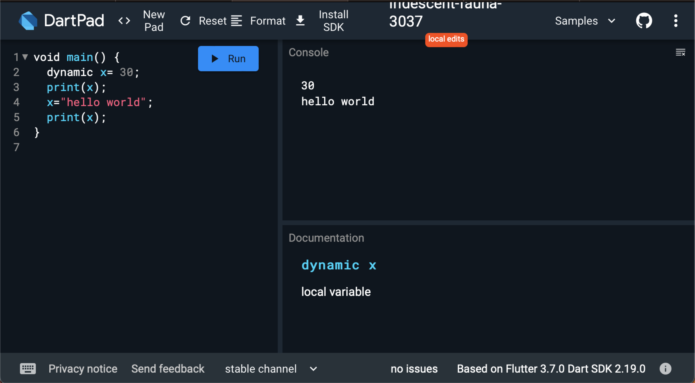
Dart Variables
Syntax: var <variable_name> = <value>;
Keyword: dynamic

Slide 13
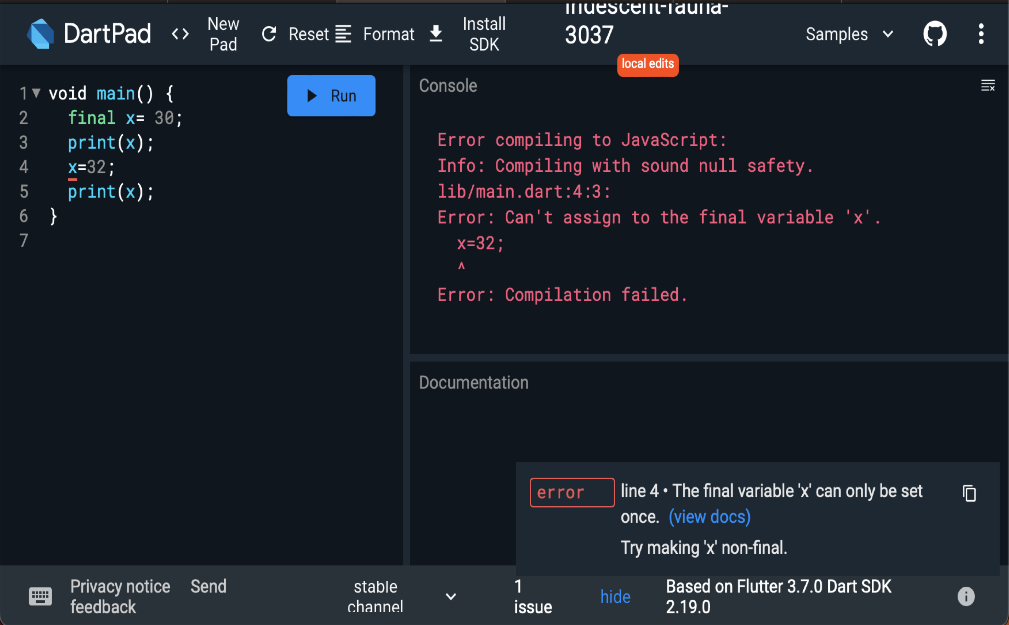
Dart Variables
final vs const
  final: The final keyword is used to hardcode the values of the variable and it cannot be altered in future, neither any kind of operations performed on these variables can alter its value (state).

Slide 14
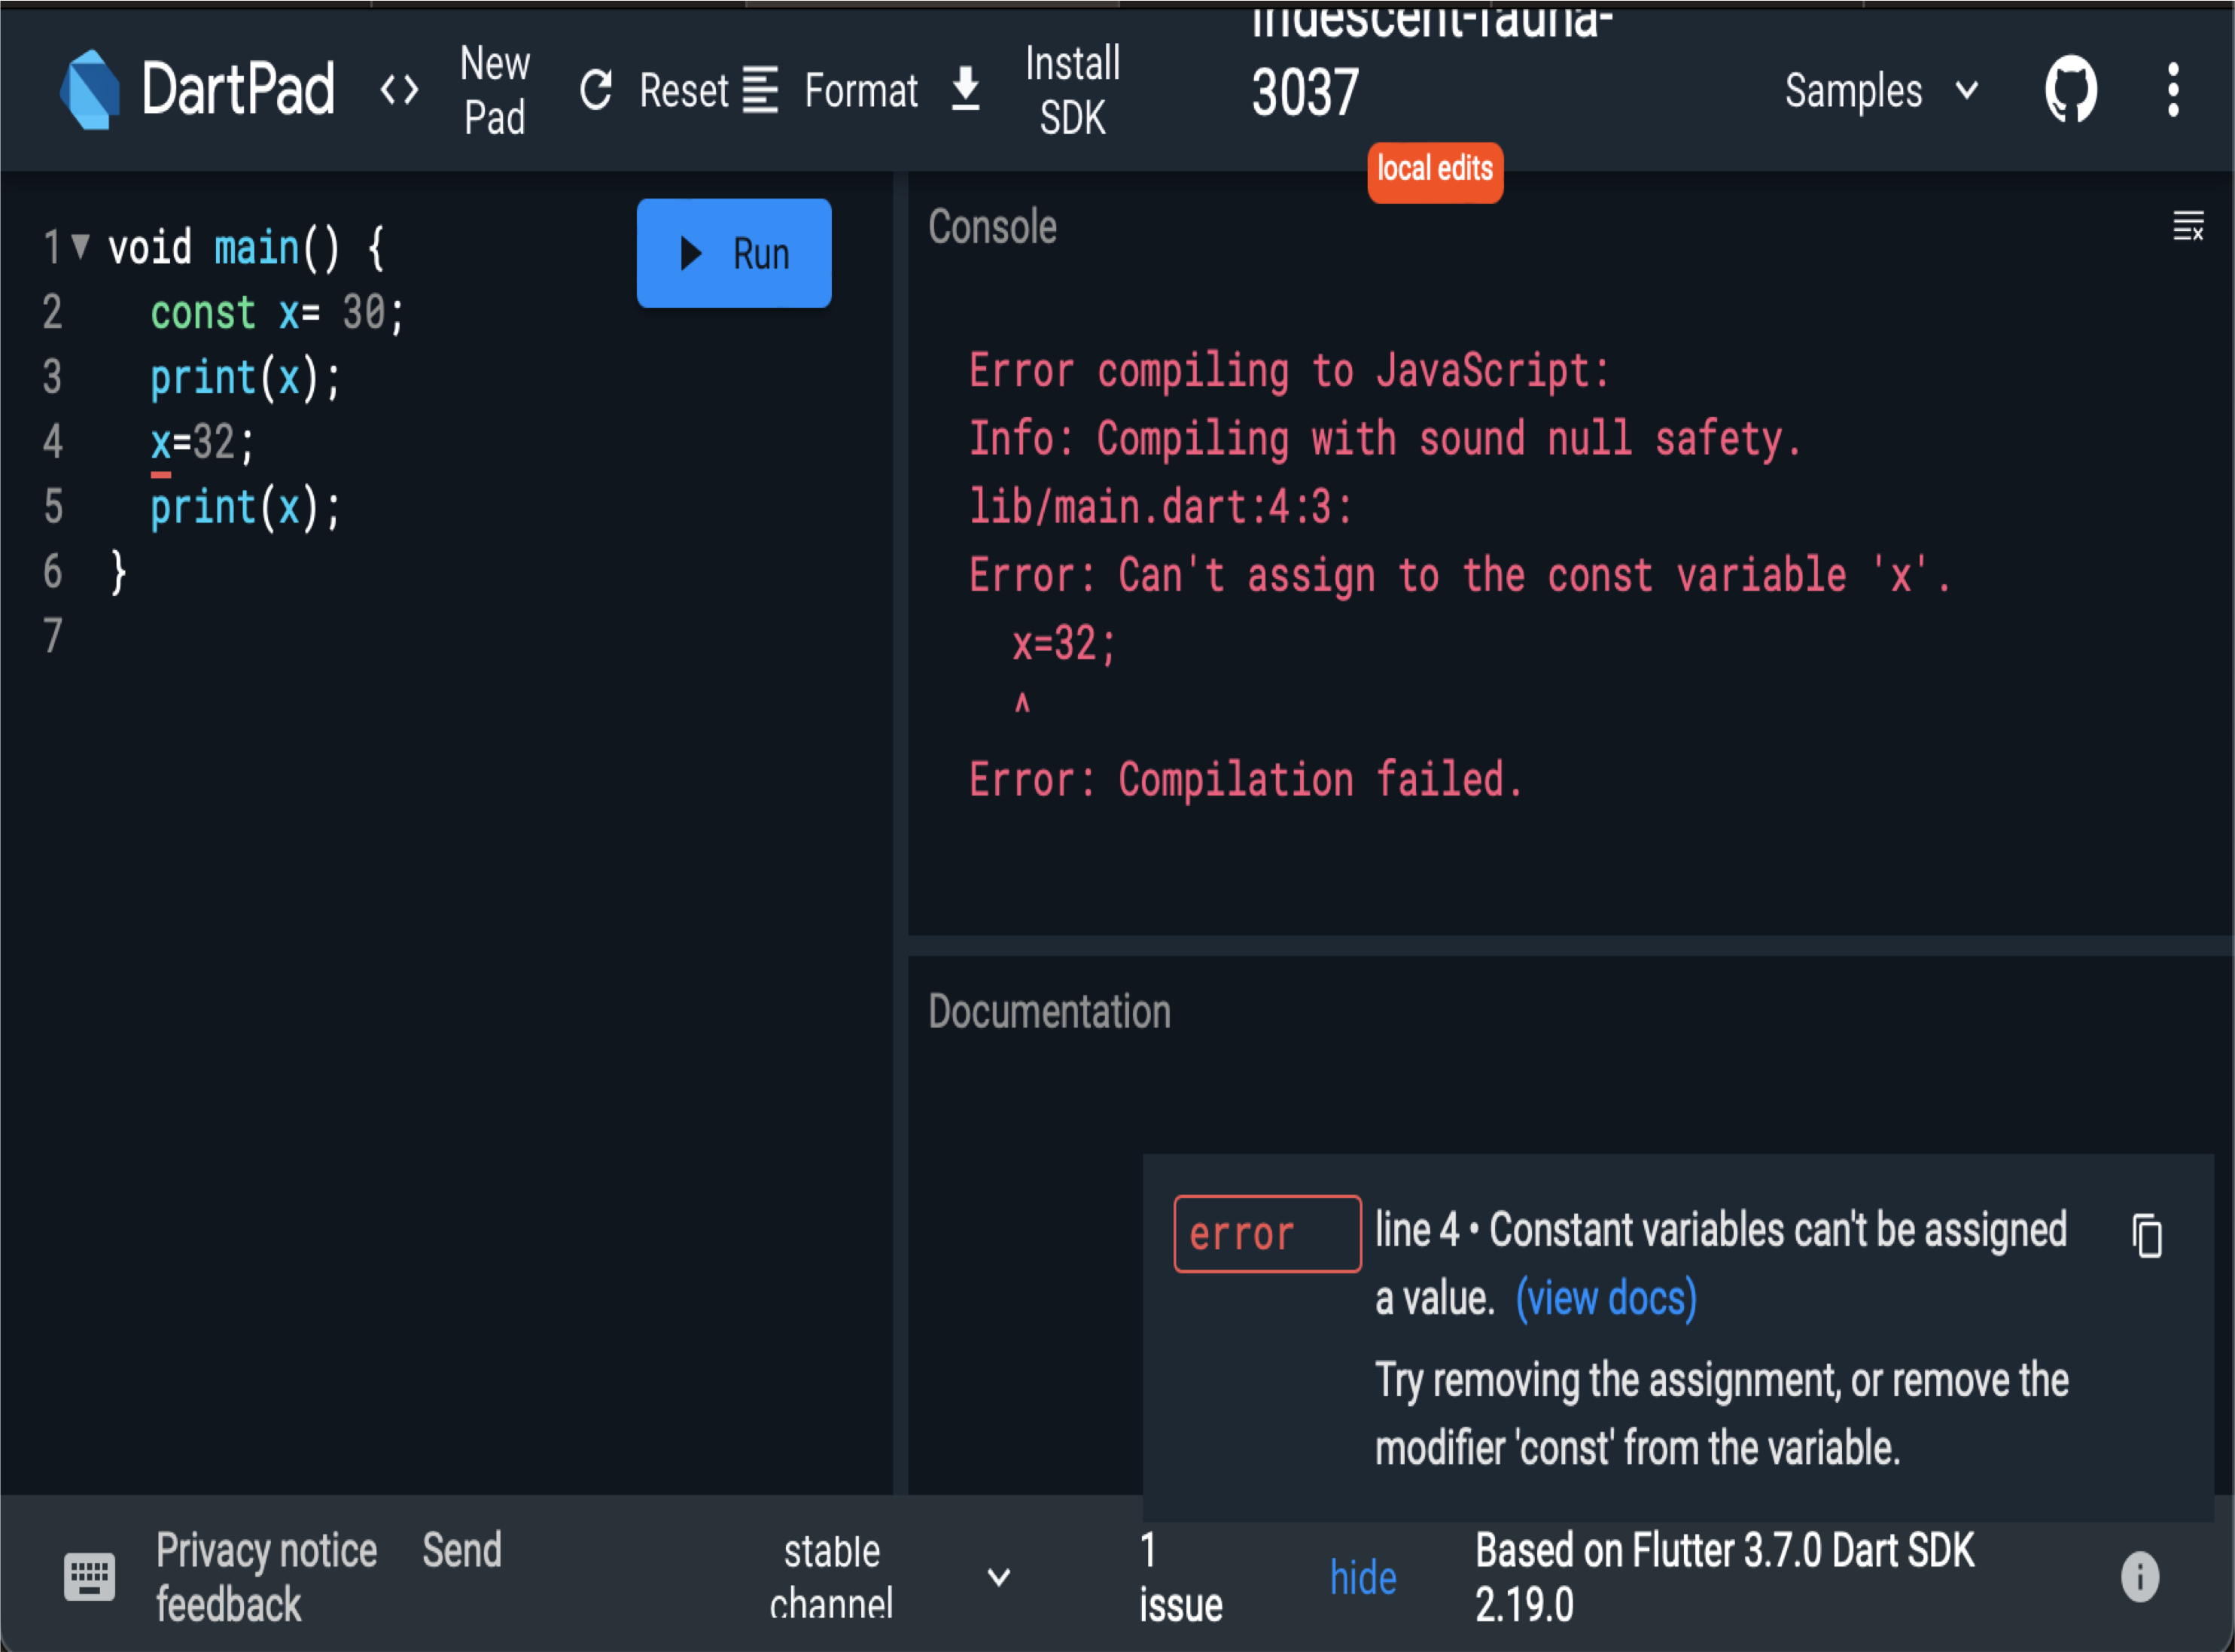
Dart Variables
final vs const
  const: The Const keyword in Dart behaves exactly like the final keyword. The only difference between final and const is that the const makes the variable constant from compile-time only. Using const on an object, makes the object’s entire deep state strictly fixed at compile- time and that the object with this state will be considered frozen and completely immutable.

Slide 15

Dart Operators
Operands represents data
Operators defines how the operands will be processed to produce a value
10 + 20
Operand Operator Operand
Arithmetic Operators: +, -, *, /, %, ++, - -
Relational Operators: <, >, <=, >=, ==, !=
Assignment Operators: =, ??=, -=, +=, *=, /=, %=
Logical Operators: &&, ||, !

Slide 16

Dart Data Type: String
The String data type represents a sequence of characters
A Dart string is a sequence of UTF 16 code units.
String values in Dart can be represented using
  Single quotes
  Double quotes
  Triple quotes
Single line strings are represented using single or double quotes.
Triple quotes are used to represent multi-line strings.

Slide 17
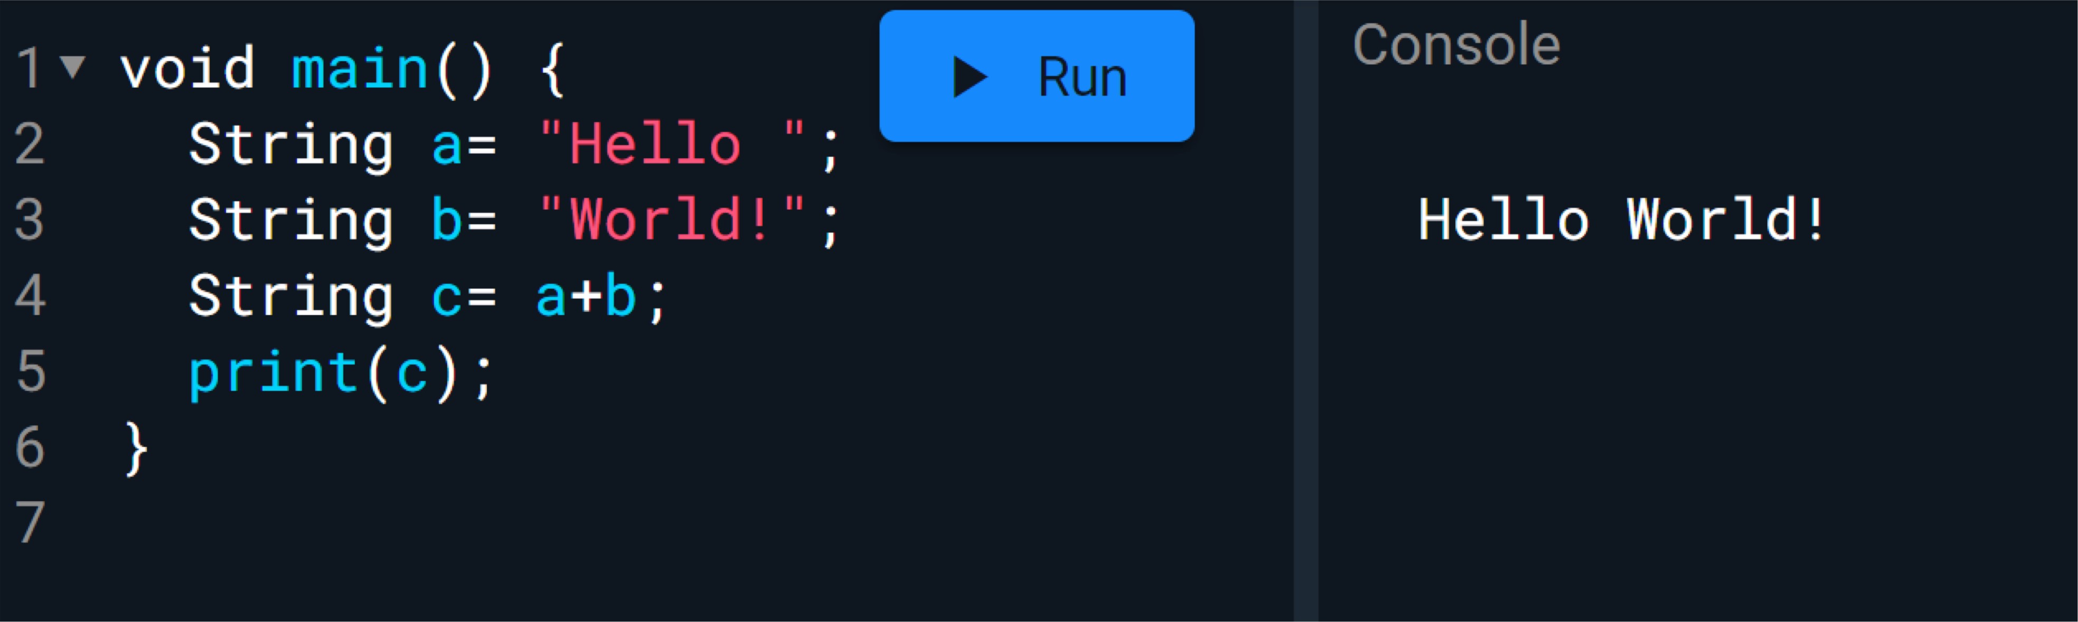
Dart Data Type: String
String Concatenation
  The + or += operator is used to merge the two string.

Slide 18
Dart Data Type: String
String Interpolation
  The string interpolation is a technique to manipulate the string and create the new string by adding another value.
  It can be used to evaluate the string including placeholders,
variables, and interpolated expression.
  The ${expression} is used for string interpolation.
  The expressions are replaced with their corresponding values.

Slide 19

Dart Data Type: String Methods
toLowerCase(): It converts all characters of the given string in lowercase.
toUpperCase(): It converts all characters of the given string in uppercase.
trim(): It eliminates all whitespace from the given string.
compareTo(): It compares one string from another.
replaceAll(): It replaces all substring that matches the specified pattern with a given string.
split(): It splits the string at matches of the specified delimiter and returns
the list of the substring.
substring(): It returns the substring from start index, inclusive to end index.
toString(): It returns the string representation of the given object.
codeUnitAt(): It returns the 16-bits code unit at the given index.

